Slide 1
Chapter 08
Knowledge Management Tools

Slide 2
Objectives
Knowledge Capture and Creation Tools
Visualization Tools and Knowledge Maps
Knowledge Sharing and Dissemination Tools
Knowledge Acquisition and Application Tools
Strategic Implications of KM Tools
Practical Implications of KM Tools

Slide 3
KM Tools
The latest solutions on a single platform for:
  Information sharing and CRM
  Project, task and event management
  Online file server and document management
  Data exchange and synchronization
  Incident tracking
  Website content management

Slide 4
Introduction
Ruggles (1997) classify KM technologies as tools that:
  Enhance and enable knowledge creation, generation, codification and transfer
    Create or generate improved knowledge
    Codify to make available for others
    Transfer knowledge to decrease problems with time and space when communicating in an organization
    Efficiency of work
The choice of tools to be used should be align with the organization’s goals and strategy, and so on

Slide 5
Introduction
Rollet’s (2003) scheme of KM Tech:
  Communication
  Collaboration
  Content creation, authoring
  Content management
  Adaption
  E-learning
  Personal tools
  Artificial intelligence
  Networking

Slide 6
Introduction
Alan Frost’s KM Tools:
  Groupware system and KM 2.0
  The intranet and extranet
  Data warehousing, data mining, and OLAP
  Decision Support Systems
  Content management systems
  Documents management systems
  Artificial intelligence tools
  Simulation tools
  Semantic networks

Slide 7
What KM tools should do?
Knowledge sharing
Innovation management: recording and management of new ideas.
Comments
Ratings: point to good sources of knowledge
Participation rewards: Point systems, badges, and other symbolic
Customized collections: Allowing users to customize content collections

Slide 8
What KM tools should do?
Knowledge creation and codification phase | Knowledge sharing and dissemination phase | Knowledge acquisition and application phase
Content creation • Authoring tools • Templates • Annotations • Data mining • Expertise profiling • Mashups • Visualization • Knowledge maps • Videos (e.g. exit interviews) | Communication and collaboration technologies • Telephone/Internet telephony/Fax • Videoconferencing/web conferencing (e.g. Skype) • Chat rooms/instant messaging/Twitter • Blogs • Email/discussion forums/Wikis • Groupware and collaborative work spaces • Social media • Web 2.0/KM 2.0 | Knowledge acquisition • E-learning • Lessons learned databases • Storytelling databases • Best practices databases • Search tools

Slide 9
What KM tools should do?
Knowledge creation and codification phase | Knowledge sharing and dissemination phase | Knowledge acquisition and application phase
Content management • Taxonomies • Folksonomies • Metadata • Manual tagging and classification • Automated taxonomy systems • Automated text analysis-summarization • Archiving • Content management systems • Document management systems | Networking technologies • Intranets • Extranets • Web servers, browsers • Knowledge repository • Portal | Knowledge application • Expert systems • Decision support systems • Customization/personalization • Push/pull technologies • Recommender systems • Intelligent agents

Slide 10
Knowledge Capture and Creation Tools
Content Creation Tools
Content Management Tools

Slide 11
Content Creation Tools
  Content management system will become commodity
  CMS approached from technological and strategical view
  Content, document, record will converge to benefit of organizations. Still, there are no merged platform to accommodate
  Most commonly used is authoring (word processing to web design)
    Annotation (whether public and private) is attached comments to specific sections of a text document (by the same or different authors)

Slide 12
Content Creation Tools
  Data mining and knowledge discovery extract information from database based on statistical analysis
    Detect pattern relationship between data/information
    Conclude the rule that an be use to predict the future result
    Need a large number of input, over period of time
    Variables may be correlated but the relationship may not have meaning or usefulness.
    Why do we need reality check before concluding?
    Sample: market segmentation, customer profile, evaluation, risk analysis

Slide 13
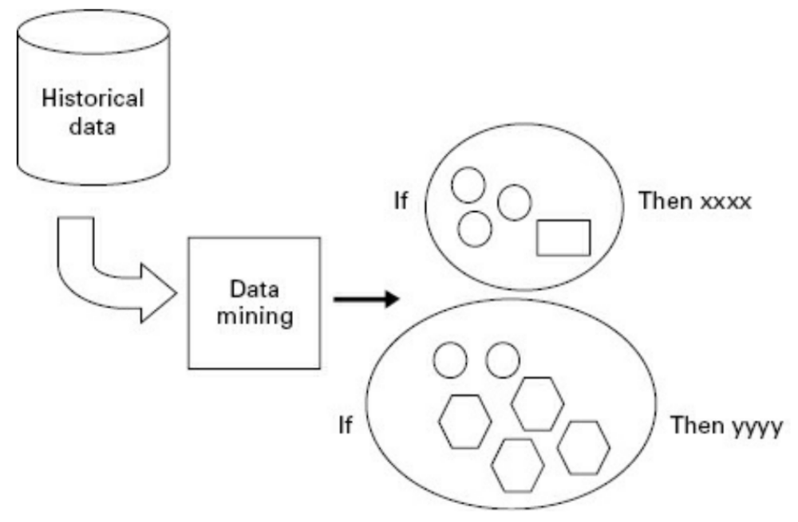

Content Creation Tools

Slide 14
Content Creation Tools
  Blogs
    Web log
    Personal used evolving to broader and wider context
    Update frequently
    Search as many KM blogs as possible. What are your finding?

Slide 15
Content Creation Tools
  Blogs
    No guarantee of authority, accuracy, lack of bias
    What a blog can do?
      Teach, entertain, inform, sharing, guidance, complain, critics, condemn, praise, sell, marketing, image builder, and many more
    What are the benefit of the blogs for you?

Slide 16
Knowledge Capture and Creation Tools
Content Creation Tools
Content Management Tools

Slide 17
Content Management Tools
  Management of valuable content throughout useful lifespan of the content
    Creation, updates, merge, summarization, repackaging, archiving, revisiting, deleting
    Using metadata to better manage content (author, keywords, date created, purpose)
    Growing information need classification to benefit the user
    The future KM will blur the boundaries between individual, group, and organizations
    Personalized KM (email. Blog, message, twitter)

Slide 18
Visualization Tools and Knowledge Maps
Visualize knowledge can assist in knowledge capture. Two commonly used ways of visualizing knowledge are knowledge maps and visualization tools.
A knowledge map is a common way of visualizing complex knowledge to be captured and codified.
Visualizing knowledge helps identify clusters which eventually can lead to knowledge categories.

Slide 19
Visualization Tools and Knowledge Maps
Knowledge maps can help classify captured knowledge and they can be used throughout the KM process cycle to help share, disseminate, and make use of the knowledge.
Data visualization is way of detecting “patterns, trends, and correlations that might go undetected in text-based data [that] can be exposed and recognized [more easily] with data visualization software

Slide 20
Visualization Tools and Knowledge Maps
Data is presented in some type of graphical or pictural form so that we can “see” the patterns.
Visualization can be thought of as visual data mining
Data visualization software coherently present a large amount of information in a small space.
They make use of the human computer-your eyes-to detect patterns and walk around the data points.

Slide 21
Visualization Tools and Knowledge Maps
Videos for Exit Interviews
  Powerful media to capture expertise in exit interviews.
  While they are operationally useful, for knowledge capture, much more time is needed than a short interview at the end of someone’s career.
  Bank’s video stories: a minority of organizations would use actual filming to achieve “documentary” quality.

Slide 22
Visualization Tools and Knowledge Maps
Mobile Tools
  Smartphones and tablets are increasingly popular and they have a range of functionalities including voice recording, photo capture, and even video recording.
  They offer the potential to assist in knowledge capture and codification.

Slide 23
Visualization Tools and Knowledge Maps
Content Management Tools
  Management of valuable content throughout the useful lifespan of the content.
  Content lifespan will typically begin with content creation, handle multiple changes and updates, merging, summarization, and other repackaging, and will typically end with archiving.

Slide 24
Visualization Tools and Knowledge Maps
Content Management Tools
  Metadata is used to better manage content throughout its useful lifespan.
    Metadata includes such information as source/author, keywords to describe content, date created, date changed, quality, best purposes, annotations by those who have made use of it, and an expiry or “best before” date where applicable.
    Additional attributes such the storage medium, location, and whether or not it exists in a number of alternative forms are also useful to include.

Slide 25
Visualization Tools and Knowledge Maps
Folksonomies and Social Tagging/Bookmarking
  Metadata is literally translated as “data about data” and refers to specific information about content contained in books, reports, articles, images, and other containers so that they can be organized and retrieved in an orderly fashion.
  Metadata is also referred to as tags or keywords.

Slide 26
Visualization Tools and Knowledge Maps
Folksonomies and Social Tagging/Bookmarking
  Three types of metadata as follows:
    Administrative metadata: information needed to manage the information resource over its lifecycle. This is sometimes referred to as preservation metadata.
    Structural metadata: relates to the actual computer elements involved such as tables, columns, and indices.

Slide 27
Visualization Tools and Knowledge Maps
Folksonomies and Social Tagging/Bookmarking
  Three types of metadata as follows (con’t):
    Descriptive metadata: refers more to the content or subject matter of the information resource to help users find it. Descriptive metadata is of greatest concern in KM because we often need to expand this type of data about data greatly in order to increase the usability (and reusability) of a given unit of knowledge.

Slide 28
Knowledge Sharing and Dissemination Tools
“The good news about computers is that they do what you tell them to do. The bed news is that what they do what you teel them to do”
-Ted Nelson-

Slide 29
Knowledge Sharing and Dissemination Tools
Collaboration tools
Wikis
Networking Technologies

Slide 30
Collaboration tools
  Communication technology always integrated with collaboration tools
  Groupware -> software that help group of colleagues attached to a communication network (e-office, lotus notes, egroupware). It allow us to do
    Meeting scheduling
    Allocating resources
    Email and newsletter
    Password protection
    File distribution

Slide 31
Collaboration tools
  Collaboration can be view as cooperate, coordinate, solve problem, compete, and negotiate
  Commonly used technologies: Tele-Videoconferencing, IM, chat, VoIP, email-list, forum
  Collaboration -> groupware productivity, technology design to facilitate the work of groups

Slide 32
Collaboration tools
  Groupware category
 | Same time, synchronous | Different time, asynchronous
Same place, colocated | Voting Presentation support | Shared computers
Different place, distant | Videophones Chat | Email Workflow

Slide 33
Collaboration tools
  The most common groupware is email
    Newsgroup deliver message to user only when they requested it (on-demand service)
    Mailing list deliver message to user when they become available (interrupt-driven service)
    Workflow system deliver message through the rule of document distribution (system) in organizations

Slide 34
Collaboration tools
  Group calendar allow scheduling, project management, and coordination
  Collaborative writing system (cloud technology)
    Asynchronous allowing user to add or comment on the previous work
    Synchronous allow user to comment as the author make the content
  Shared-workspace
  Video conferencing. When we should use it compare to conventional audio conference?

Slide 35
Collaboration tools
  Chat system permit people to write message real time. In chat group, one’s message can be see and reply by member of the group
  Moderator can be needed for leading and regulating the discussion

Slide 36
Knowledge Sharing and Dissemination Tools
Collaboration tools
Wikis
Networking Technologies

Slide 37
Wikis
  Web-based software which support open editing, and allow multi-user content creation and editing through website
  Grow and change as the will of the participants
  Composed of web pages where people input information and then create hyperlinks to another page or new pages for more details about a particular topic
  Anyone can add, delete. Or correct information. A search field allow you to enter a key work for the information you need

Slide 38
Wikis
  There are public and corporate wikis. What are the differences?
  The benefit of wikis?
    Real time
    Faster
    No need to keep a copy
    Everyone’s involve in the process have easy access
    Secure, if using commercial wiki and conduct in the intranet environment
  How many wikis you can find on the web?

Slide 39
Knowledge Sharing and Dissemination Tools
Collaboration tools
Wikis
Networking Technologies

Slide 40
Networking Technologies
  Consist of intranets, extranets, knowledge repositories, knowledge portals, and web-based shared workspaces.
  Knowledge repositories: an on-line computer-based storehouse of expertise, knowledge, experiences, and documentation about a particular domain of expertise (Liebowitz and Beckman)
  In creating a knowledge repository, knowledge is collected, summarized, and integrated across sources

Slide 41
Networking Technologies
The repository can either be filled with knowledge by
  Passive collection: where workers themselves recognize what knowledge has sufficient value to be stored in the repository
  Active collection: where some people in the organization are scanning communications processes to detect knowledge

Slide 42
Networking Technologies
Three types of knowledge repositories:
  External knowledge repositories (such as competitive intelligence, knowledge about outside parties)
  Internal knowledge repositories (such as research reports and product-oriented market material)

Slide 43
Networking Technologies
Elements of repositories:
  Declarative knowledge (concepts, categories, definitions, assumptions-knowledge of what)
  Procedural knowledge (processes, events, activities, actions, manuals-knowledge of how or know-how)
  Causal knowledge (rationale for decisions, for rejected decisions-knowledge of why)
  Context (circumstances of decisions, informal knowledge, what is and what is not done, accepted etc.-knowledge of care-why)

Slide 44
Networking Technologies
Knowledge portals
  Provide access to diverse enterprise content, communities, expertise, and to internal and external services and information (Collins, Firestone).
  Means of storing and disseminating organizational knowledge such as business processes, policies, procedures, documents, and other codified knowledge.
  Searching capabilities through content as well as through the taxonomy (categorized content).

Slide 45
Networking Technologies
Knowledge portals
  Link people, processes, and valuable knowledge content and provide the organizational glue or common thread that serves to support knowledge workers.
  The first were essentially a means of broadcasting information to all organizational members.
  Today, they have evolved into sophisticated shared workspaces where knowledge workers can not only contribute and share content but also acquire and apply valuable organizational knowledge.
  Support knowledge creation, sharing, and use by allowing a high level of bidirectional interaction with users.

Slide 46
Knowledge Acquisition and Application Tools
E-learning systems
  Provide support for learning, comprehension, and better understanding of the new knowledge to be acquired
Electronic performance support systems (EPSS), expert systems, and decision support systems (DSS) help knowledge workers to apply the knowledge on the job
Adaptive technologies can be used to personalize knowledge content push or pull

Slide 47
Knowledge Acquisition and Application Tools
Recommender systems
  Detect similarities or affinities between different types of users
  Make recommendations of additional content that others like them have found to be useful to acquire and apply
Knowledge maps and other visualization tools can help to be better acquire and apply valuable knowledge
Artificial intelligence can at least partially automate processes such as text summarization, content classification, and content selection

Slide 48
Knowledge Acquisition and Application Tools
E-learning applications
  Computer-based learning (CBT) and web-based training (WBT) applications
  The common feature is online learning environment. Courses delivered via web or intranet
  Increase the knowledge dissemination because
    Knowledge that has been captured and coded or packaged made available to all organizational members, regardless of any time or distance constraints

Slide 49
Knowledge Acquisition and Application Tools
Decision Support System
  Help groups in decision making by facilitating meetings, encourage equal participation by providing anonymity or enforcing turn-taking
  Provide tools for brainstorming, critiquing ideas, voting, putting weights and probabilities on events and alternatives

Slide 50
Knowledge Acquisition and Application Tools
Intelligent Filtering Tools
  Software programs that assist their user and act on his or her behalf
  A computer program that acts autonomously and on its own initiative, has intelligence and can learn, improving its performance in execting its tasks (Woolridge, Jennings)

Slide 51
Knowledge Acquisition and Application Tools
Intelligent Filtering Tools
  Has features:
    Autonomy: the ability to do most of their tasks without any direct assistance from an outside source
    Social ability: the ability to interact with, when they deem appropriate, other software agents and humans
    Responsiveness: the ability to respond in a timely fashion to perceived changes in the environment
    Personalization: the ability to adapt to its users’ needs

Slide 52
Knowledge Acquisition and Application Tools
Intelligent Filtering Tools
  Has features:
    Initiative: the ability of an agent to take initiatives by itself, autonomously and spontaneously, often on a periodical basis
    Adaptivity: the capacity to change and improve according to the experiences accumulated
    Cooperation: the interactivity between agent and user

Slide 53
Knowledge Acquisition and Application Tools
Intelligent Filtering Tools
  The category:
    Watcher agents: look for specific information
    Learning agents: tailor to an individual’s preferences by learning from the user’s past behavior
    Shopping agents: compare “the best price for an item”
    Information retrieval agents: help the user to “search for information in an intelligent fashion”
    Helper agents: perform tasks autonomously without human interaction

Slide 54
Knowledge Acquisition and Application Tools
Intelligent Filtering Tools
  Information overload problem
    Information filtering: go through an enormous amount of information to find the small portion that is relevant.
    Information gathering: There is not enough information available to us and we have to search long and hard to find what we need.
  We are through in information but starved for knowledge (Rutherford Rogers)

Slide 55
Knowledge Acquisition and Application Tools
Adaptive Intelligent System
  Used to better target content to a specific knowledge worker, or to a specific group of knowledge workers who share common work needs.
    Customization: manually changing their knowledge environment, for example, selecting user preferences to change the desktop interface, specifying certain requirements in content to be provided to them (language, format), or subscribing to certain news or listserv services.
    Personalization: refers to automatically changing content and interfaces based on observed and analyzed behaviors of the intended end user.

Slide 56
Summary
Understand the role of communication tech technologies and the benefit of using it as tools to support KM

Slide 57

Discussion / Homework / Team Activities
What are the major categories and what sorts of patterns would data mining technologies detect?
Describe an application of blog technology within an organization.
How would you categorize the different forms of groupware or collaboration technologies?
What role can a Wiki play in promoting group collaboration? What advantages does a Wiki offer when compared to a discussion forum?
Describe how you would attempt to accommodate different user skill levels and expectations in the same organization.
Select one new emerging technology and list its potential uses for knowledge management.
Select any KM technology and describe how it may be applied at the individual, group, and organizational level.

